Slide 1
Entity Relationship Diagram
word1
id
pic1
word2
HaroofETahaji
pic2
word3
pic3
harf

Slide 2

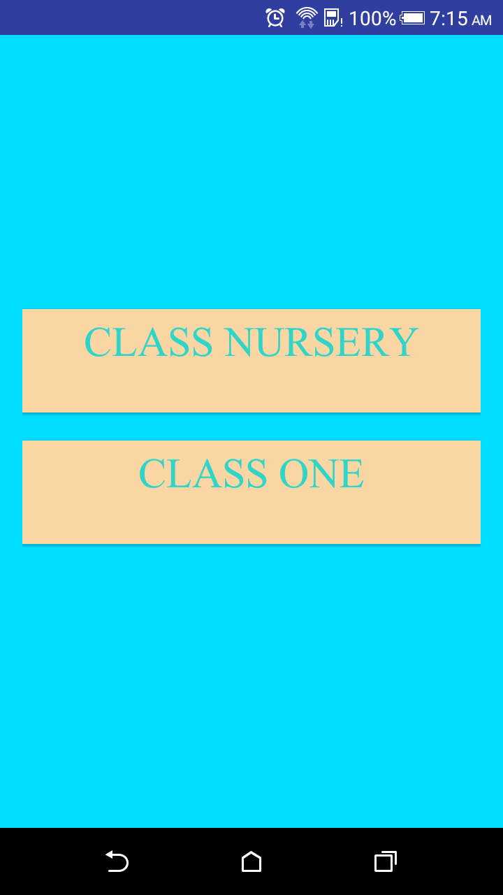
Welcome Screen & Select Classes Preview

Slide 3
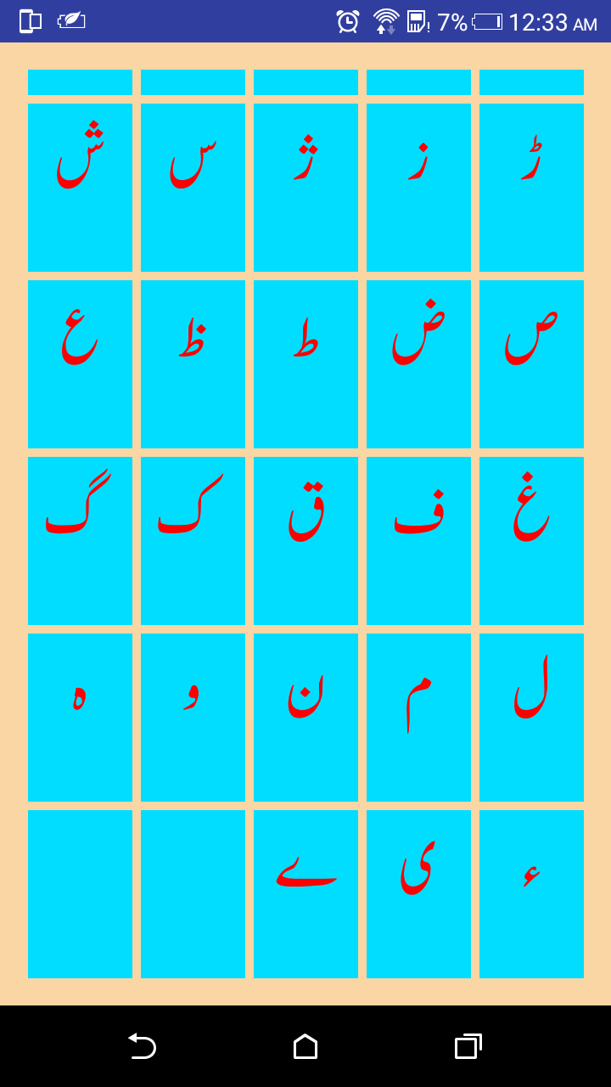
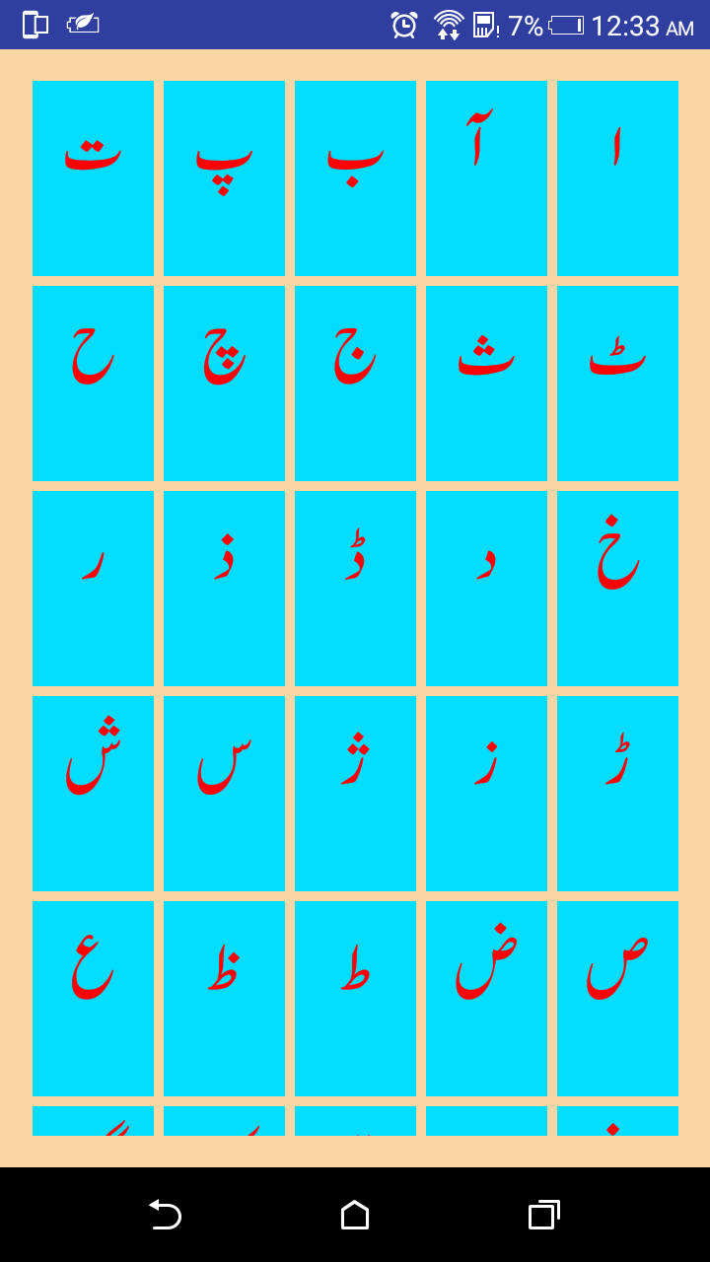
Haroof e Tahajji (Class Nursery) Preview

Slide 4
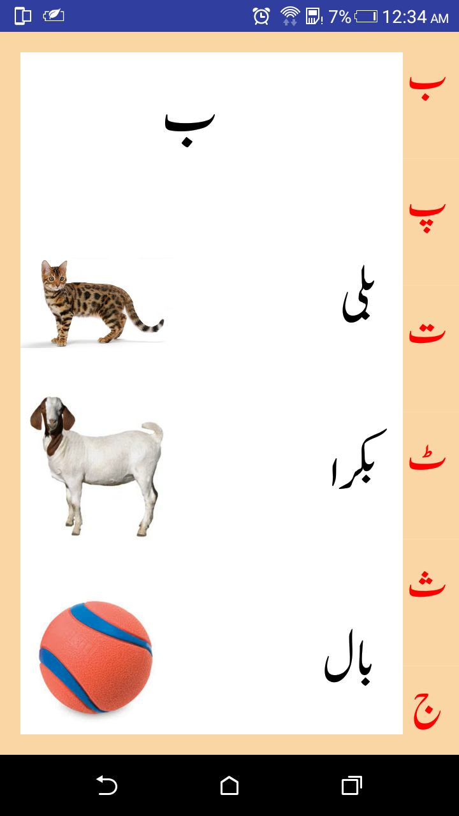
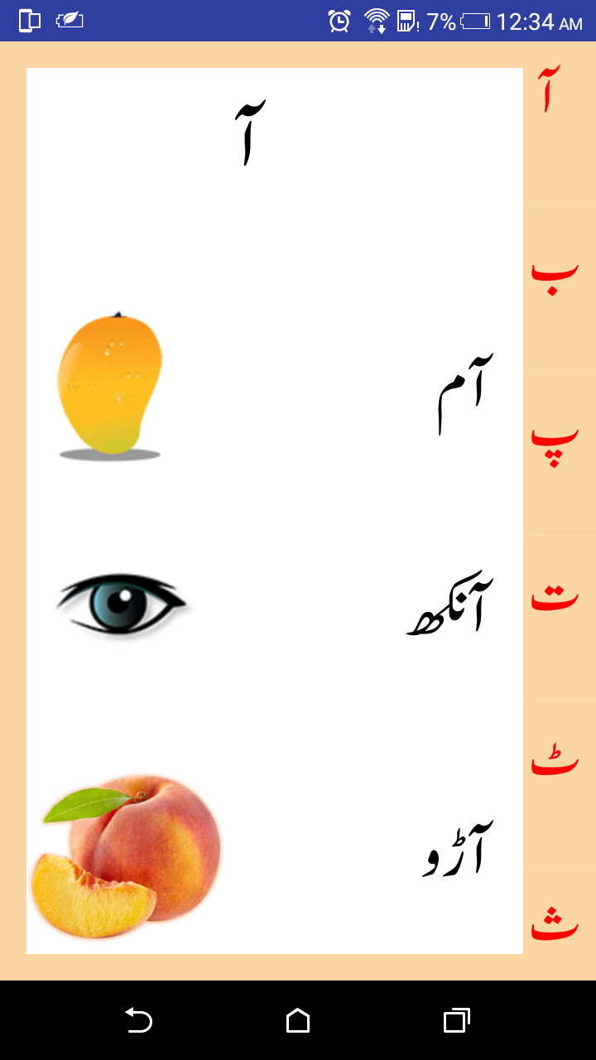
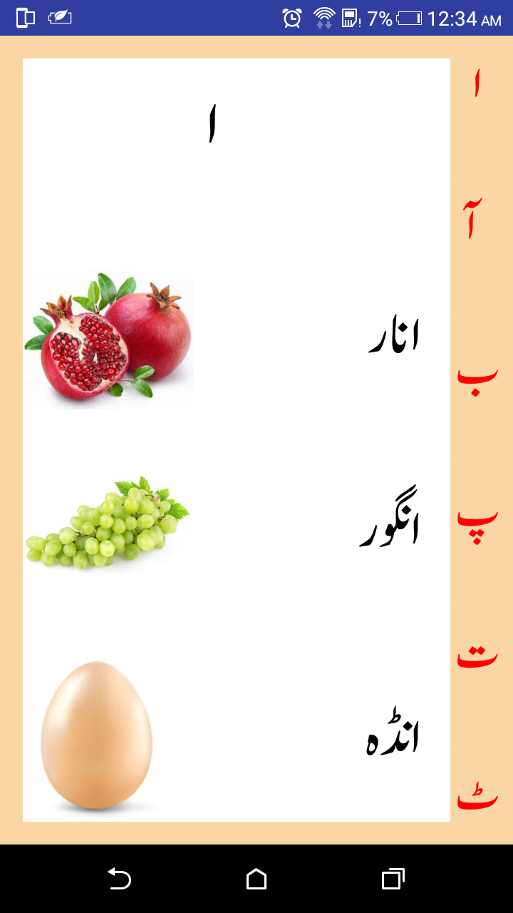
Haroof detail activity (Class Nursery) Preview

Slide 5
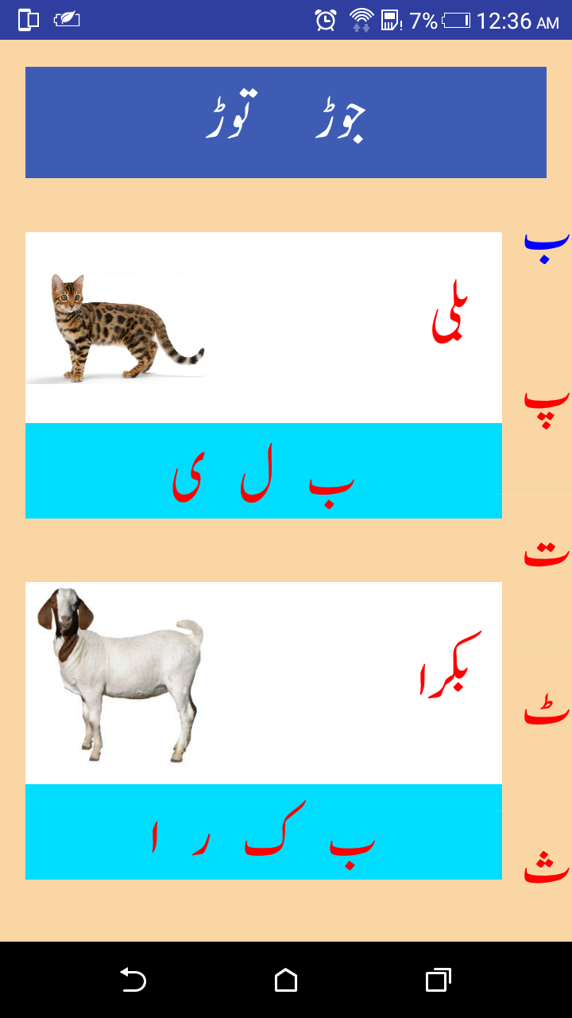
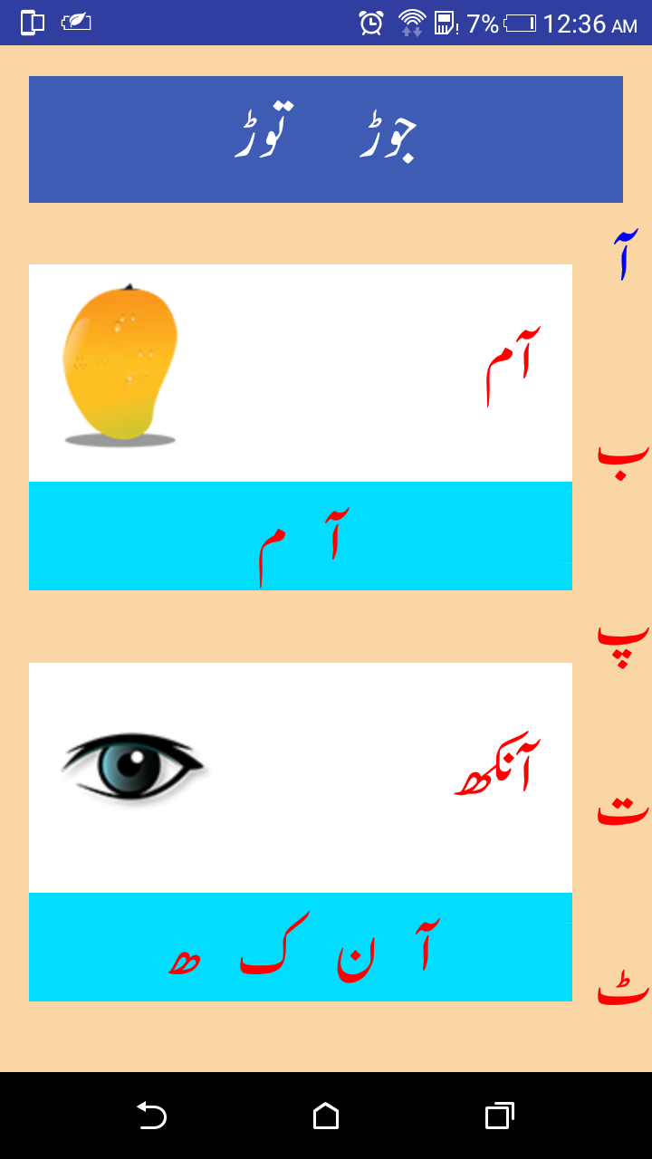
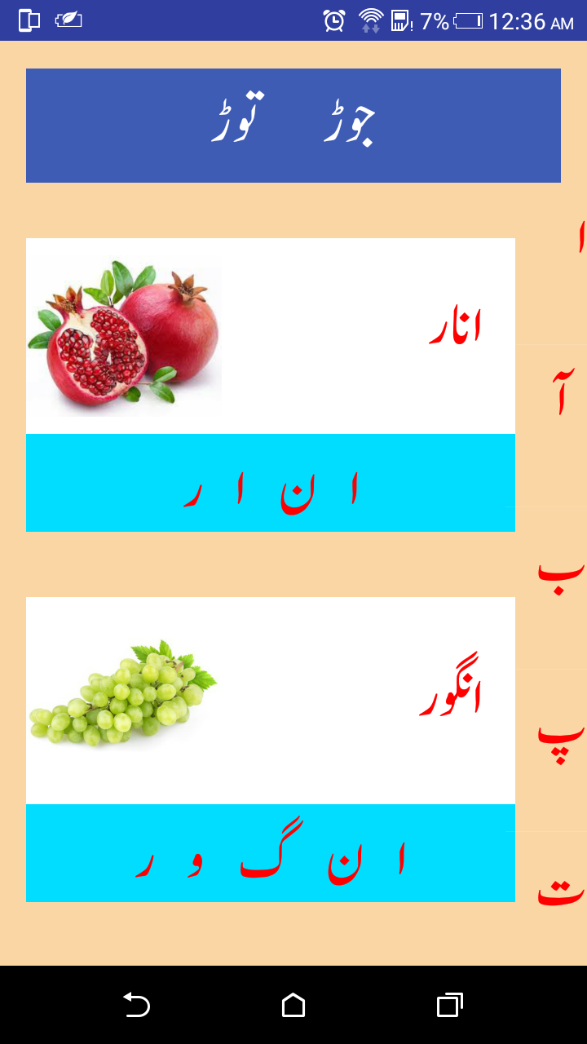
Jor Tor (Class One) Preview

Slide 6
Thank You

